Slide 1
EP PROJECT
PROBLEM STATEMENT:
MPPT solar charge controller using Lt3652
GROUP-7
E.Jaswanth Krishna – S20200020257
G.Sneha Mayi – S20200020261
V.Rohith – S20200020313

Slide 2
OBJECTIVES:
To charge a battery with a solar panel, the most popular choice is the MPPT or maximum power point tracker topology.
Because it provides much better accuracy than other methods like PWM controlled chargers.
MPPT gives its best efforts to charger the battery ,even sunlight is poor. The charge controller measure output voltage and battery voltage. Then it decides the best power from the above conditions.

Slide 3
The MPPT Charge controller circuit that we design in this project will have the following specifications:
It will charge a 2P2S battery (6.4-8.4V)
Charge current will be 600mA
It will have an additional charging option using an adapter.
WORK DONE SO FAR:
We completed the solar charge controller circuit in eagle software. It is the schematic diagram of the problem we are working on.
For this we have installed LT3652 library to complete this schematic.
We have designed 3 PCB layouts for the same schematic to achieve the compact version of the layout with minimal VIA’s

Slide 4
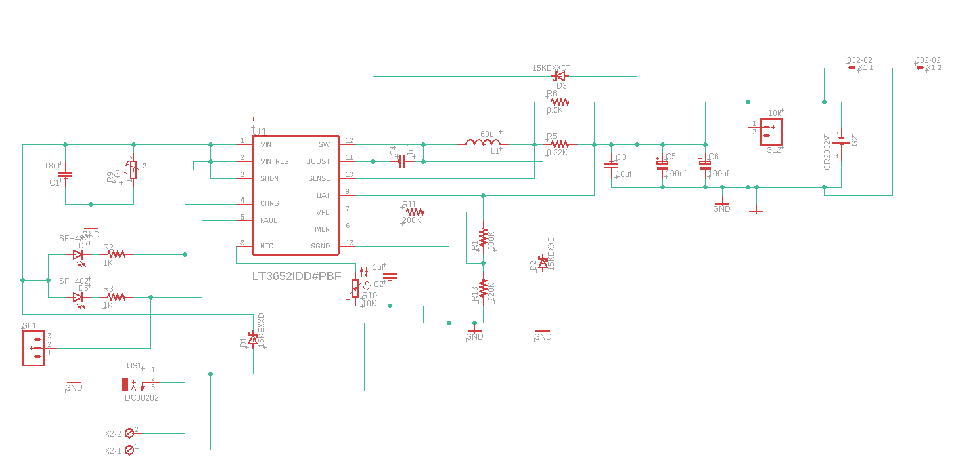
Schematic diagram of the MPPT Solar Charge Controller circuit

Slide 5
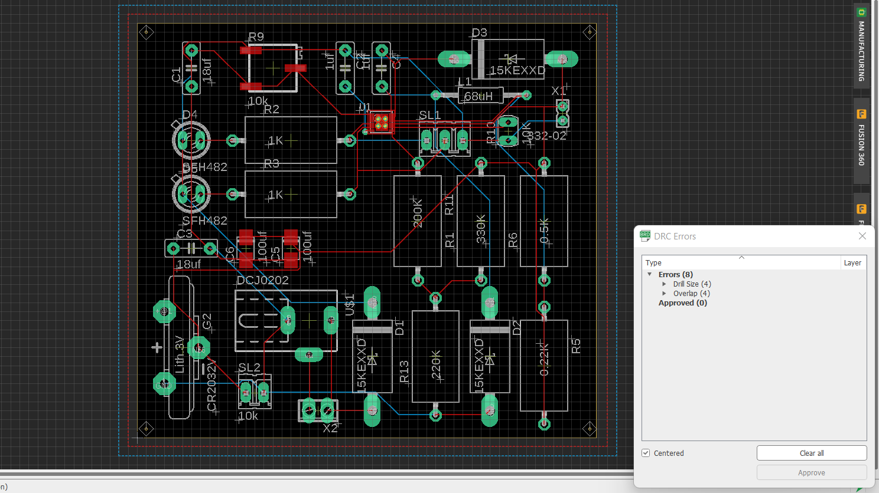
Layout - 1

Slide 6
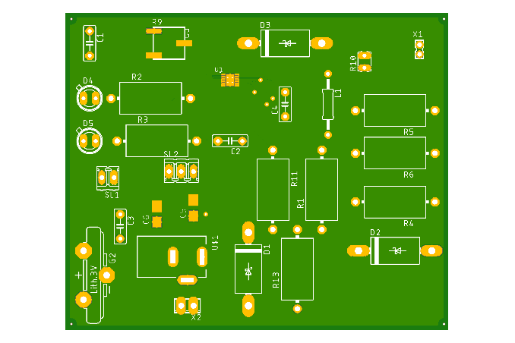
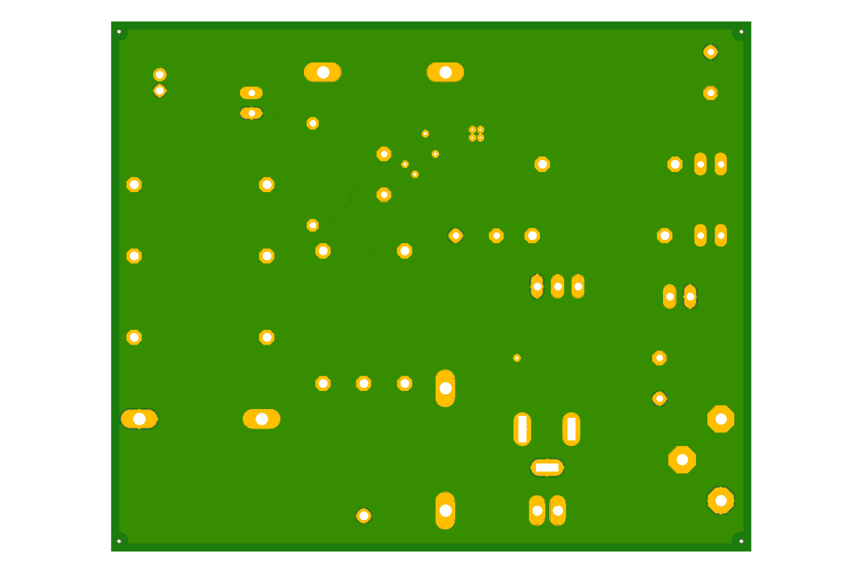
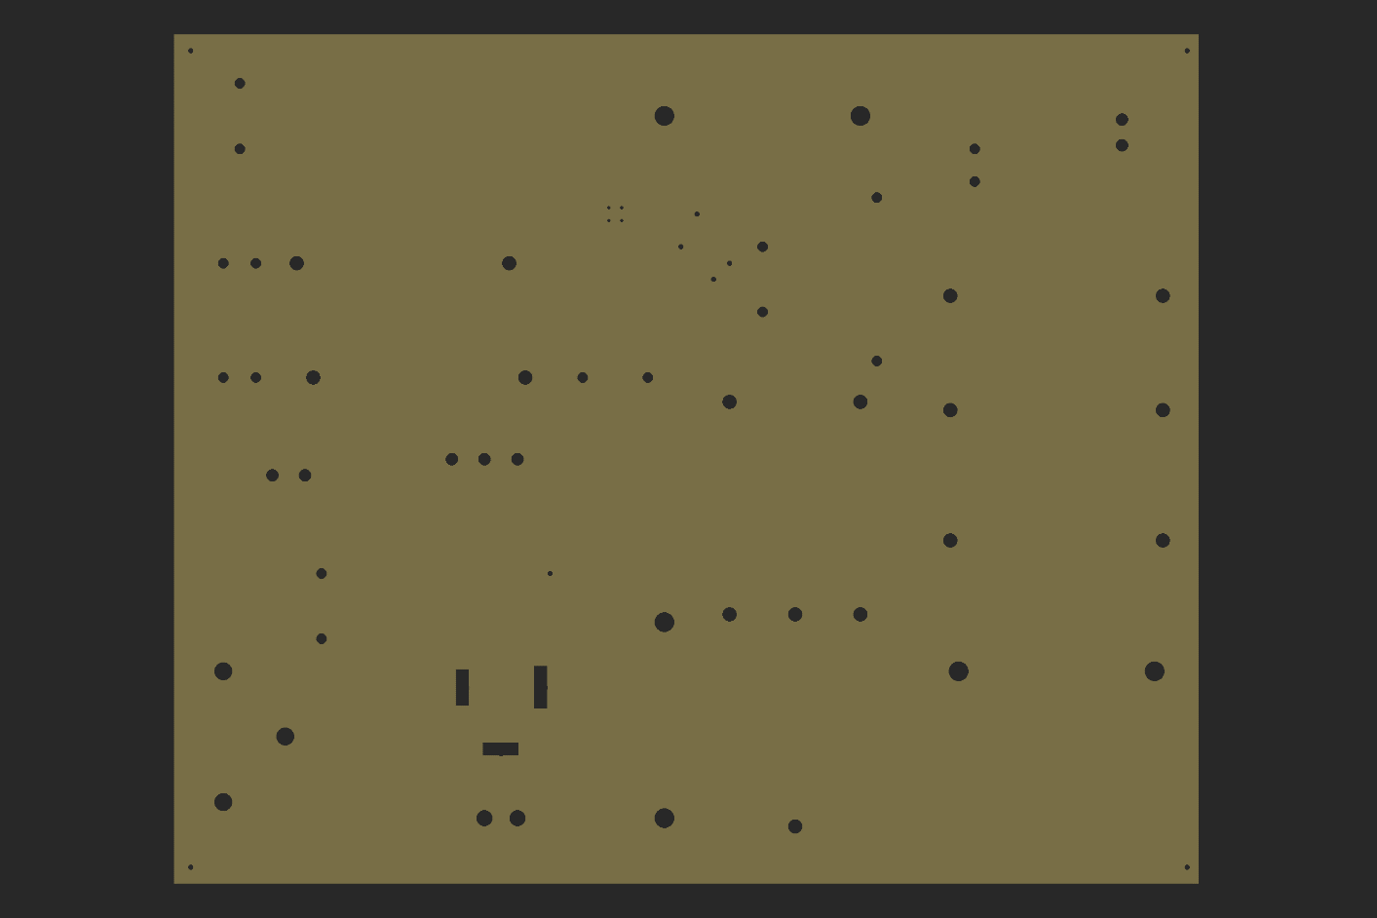
LAYOUT – 1
TOP VIEW BOTTOM VIEW
DRILLS :

Slide 7
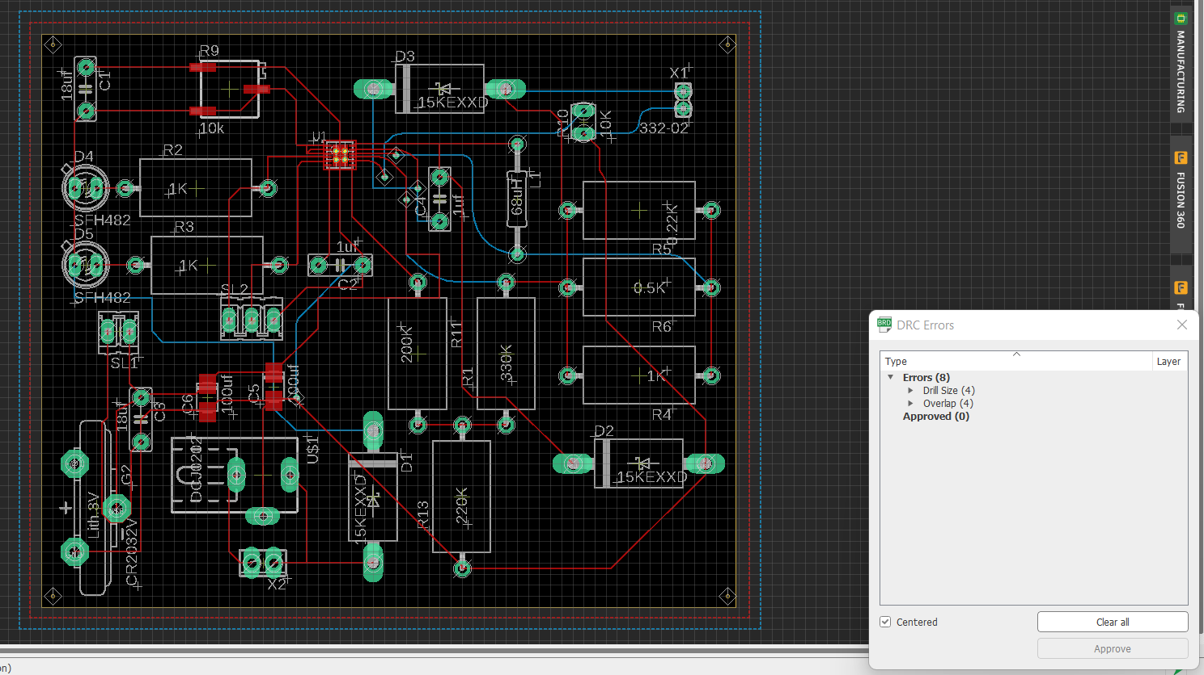
LAYOUT - 2

Slide 8
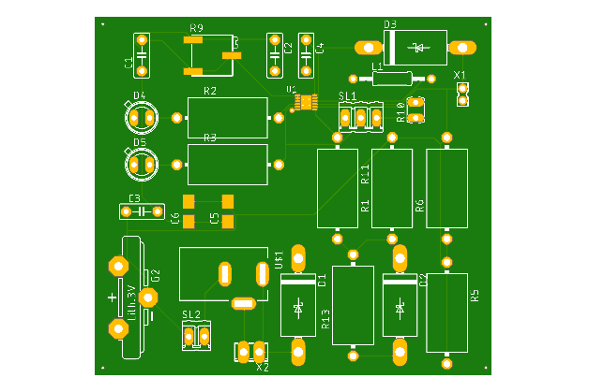
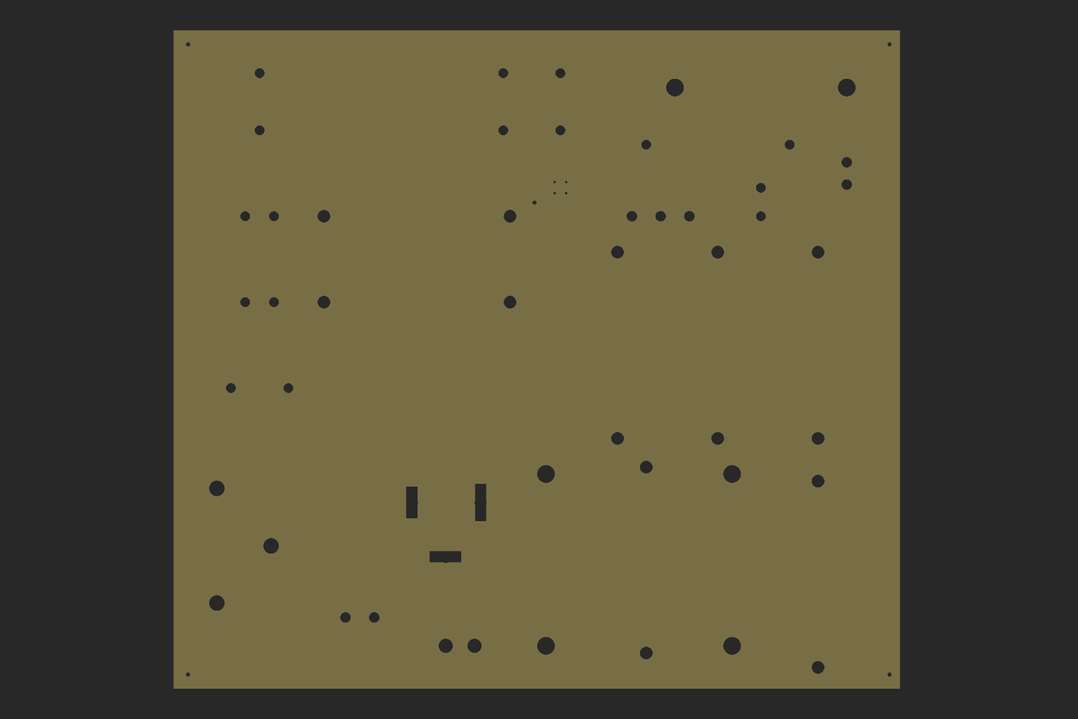
LAYOUT - 2 TOP VIEW : BOTTOM VIEW :
DRILLS :

Slide 9
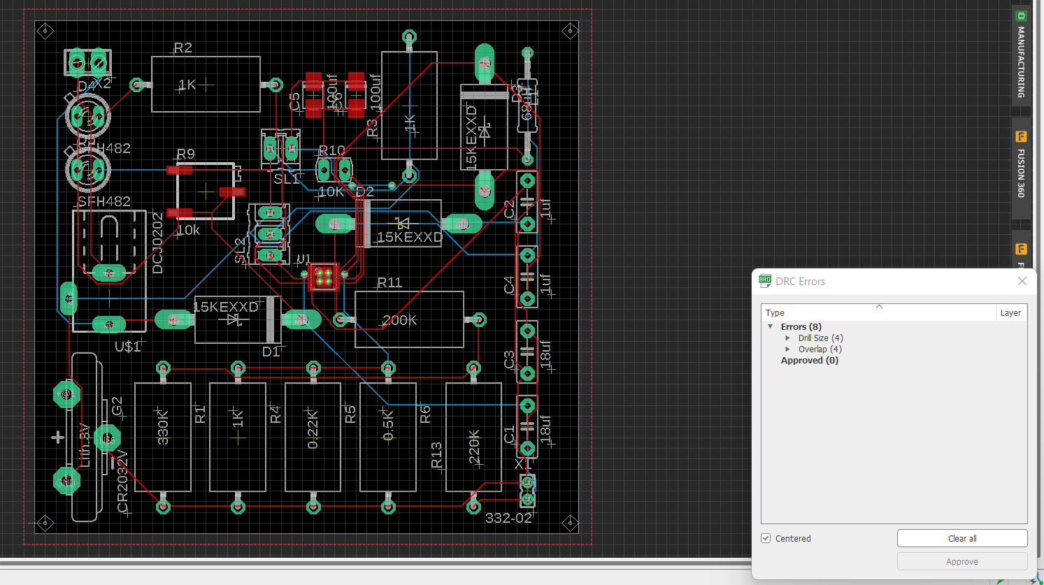
LAYOUT - 3

Slide 10
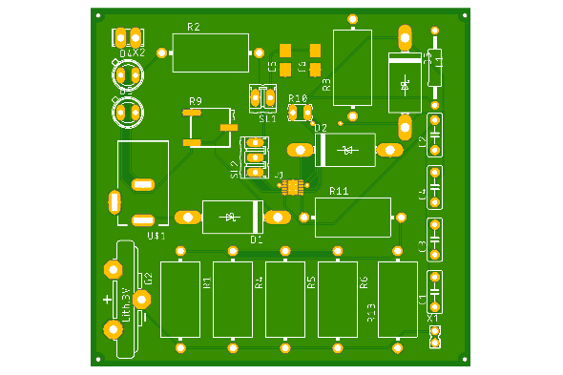
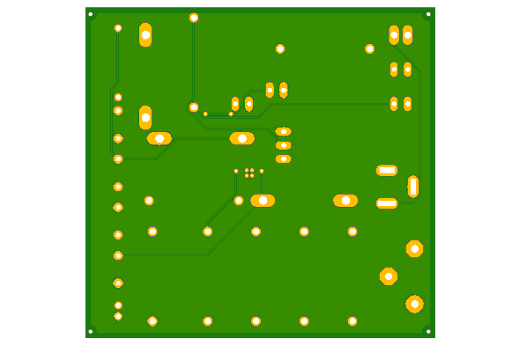
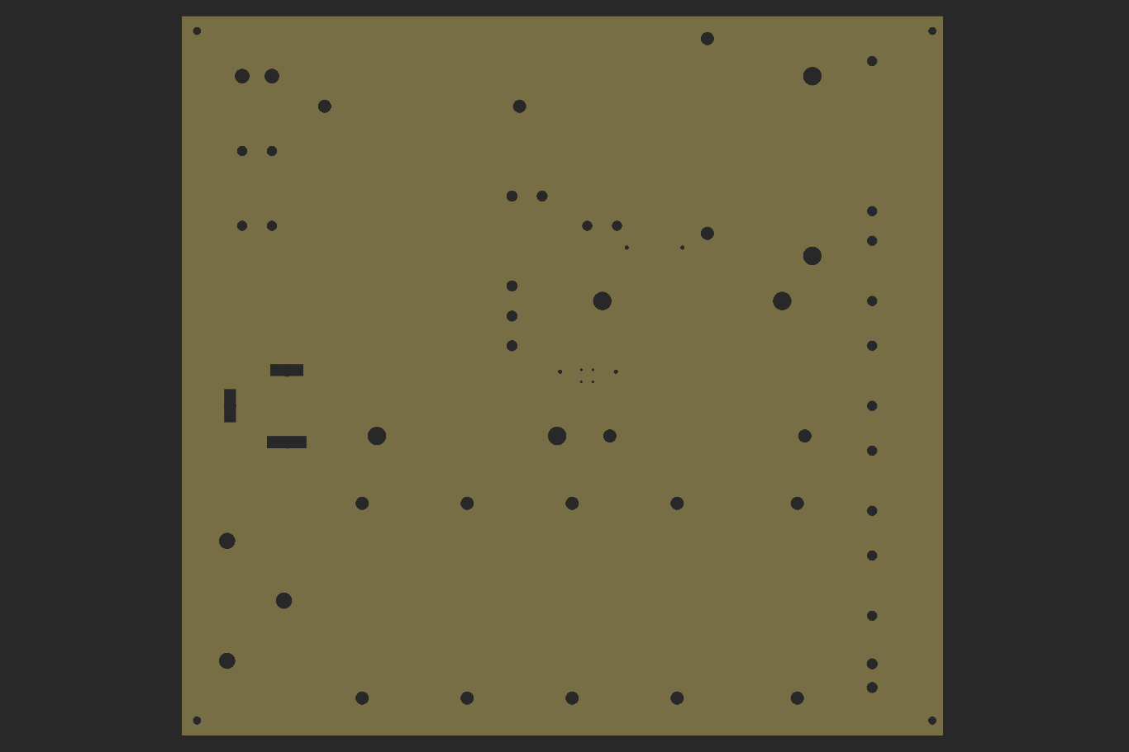
LAYOUT - 3 TOP VIEW : BOTTOM VIEW :
DRILLS :

Slide 11
CONTRIBUTION OF EACH TEAM MEMBER:
Jaswanth (S20200020257) – schematic and PCB Layout
SnehaMayi (S20200020261) – schematic and PCB Layout
Rohith (S20200020313) – schematic and PCB Layout

Slide 12
THANK YOU

